Slide 1

SREENIDHI INSTITUTE OF SCIENCE & TECHNOLOGY
Department of Computer Science and Engineering
Project Seminar on IMAGE CLASSIFICATION Using CNN
BY
Madhan (18311A05L9)
Shashank (18311A05Q0)
Karthik (19315A0519)
Under the guidance of
Ms. Neha Dr Aruna Varanasi
Internal Guide Head of the Department

Slide 2
Abstract
Image classification is the most critical use case in digital image analysis.
CIFAR-10 is a very popular computer vision dataset. This dataset is well studied in many types of deep learning research for object recognition.
This dataset consists of 60,000 images divided into 10 target classes, with each category containing 6000 images of shape 32*32. This dataset contains images of low resolution (32*32), which allows researchers to try new algorithms. The 10 different classes of this dataset are:
Airplane
Car
Bird
Cat
Deer
Dog
Frog
Horse
Ship
Truck
CIFAR-10 dataset is already available in the datasets module of Keras. We do not need to download it; we can directly import it from keras.datasets

Slide 3
Existing System
In the existing system, there is a great gap between the train and test accuracies made which indicates the overfitting in them.
The existing methods of image classification of Cifar10 gives less accuracy when compared.
The existing system need to have optimized for having decent results.

Slide 4
Proposed System
This gives the straight forward approach for identifying different images from the dataset.
The proposed system has been improved with the both training accuracy and test accuracy without overfitting.
The proposed system had been optimized with the Adam optimizer for the better results.
The images can be predicted from the dataset using the Cnn algorithm at a greater ease.
It improves the quality of image classification.
The proposed system can be easily adapted to a wide variety of fields, science and technology.

Slide 5
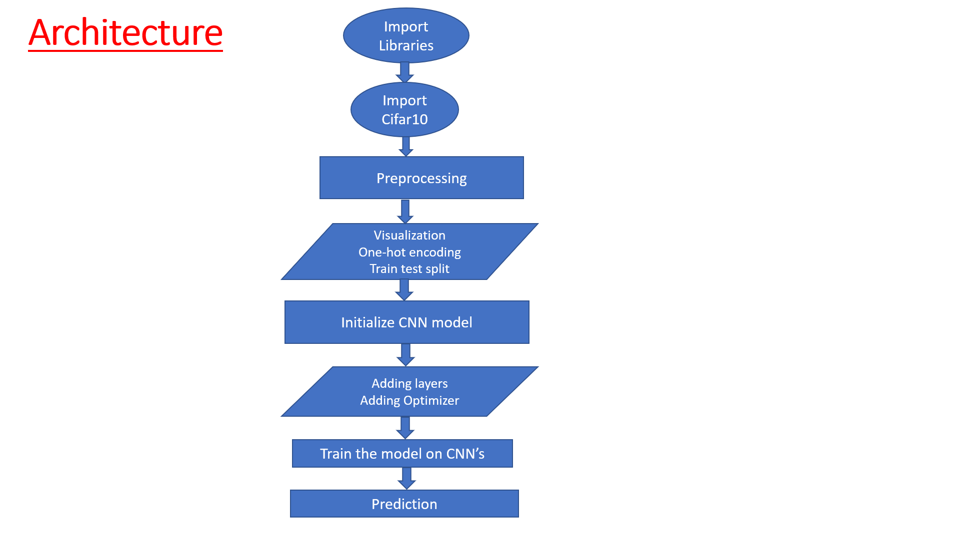
System Architecture

Slide 6
Data Flow Diagram

Slide 7
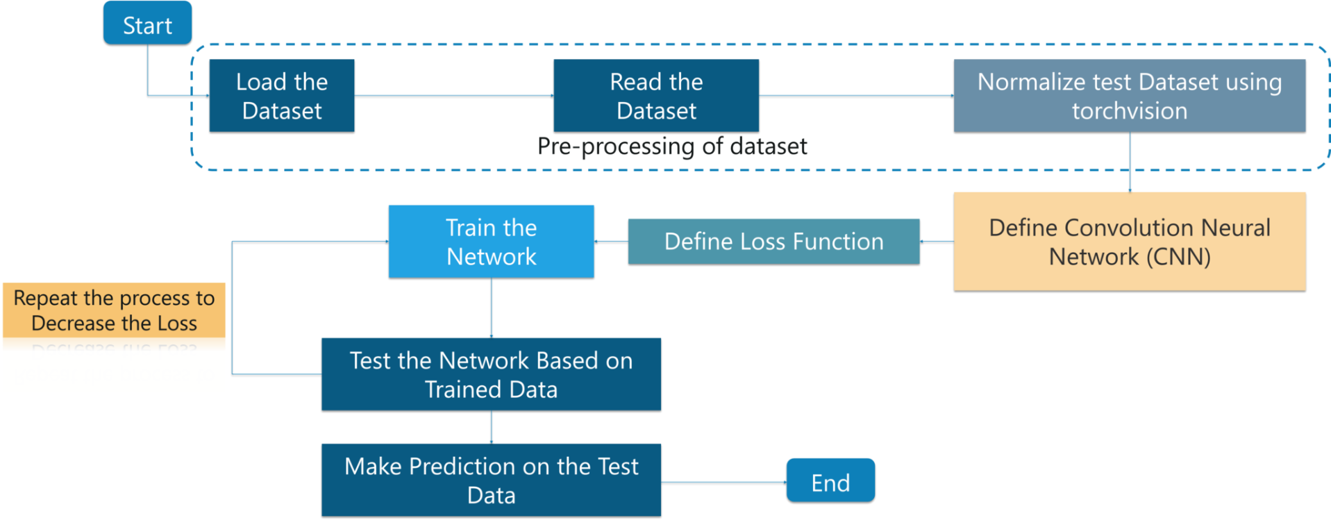
Data Flow

Slide 8
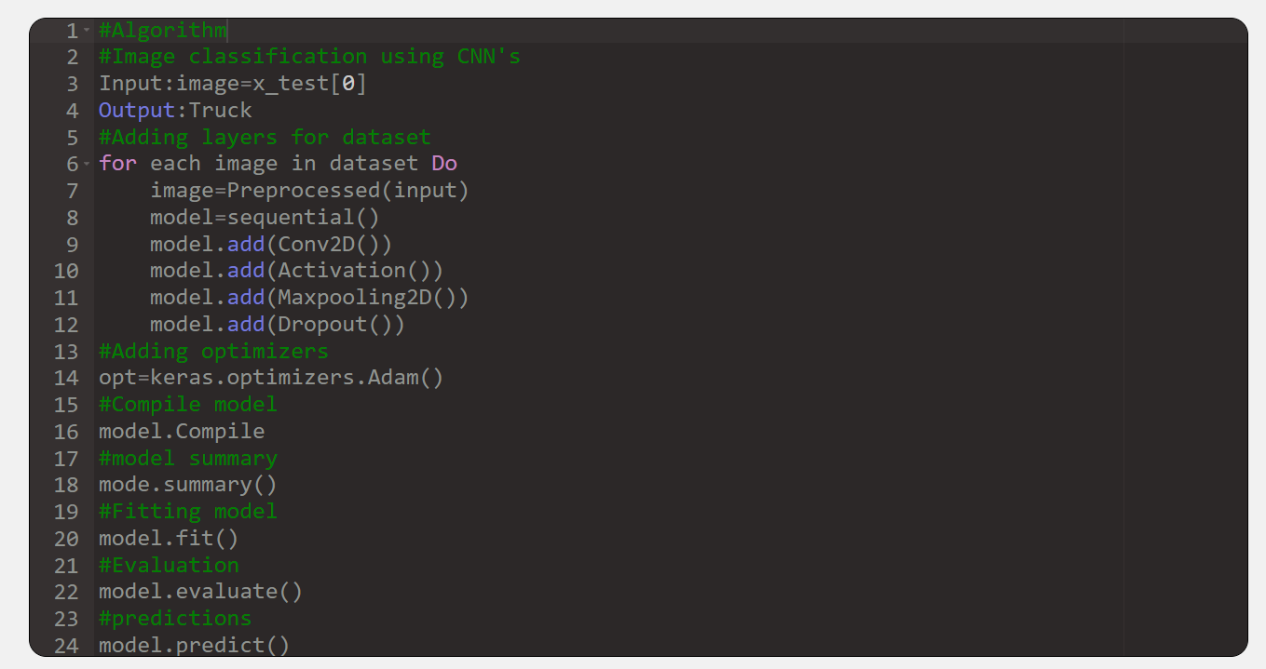
Algorithm

Slide 9
Screen Shots

Slide 10
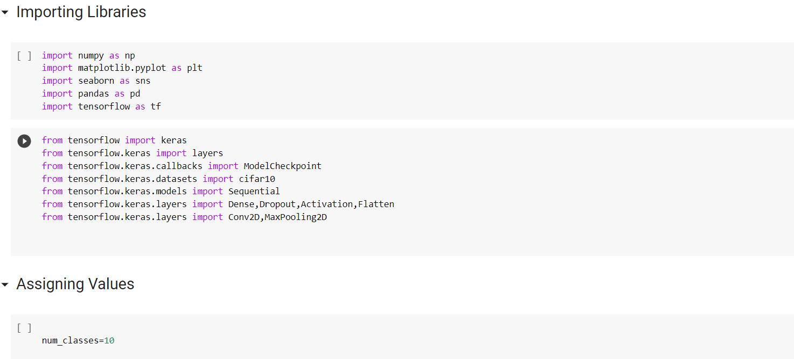
Importing Libraries

Slide 11
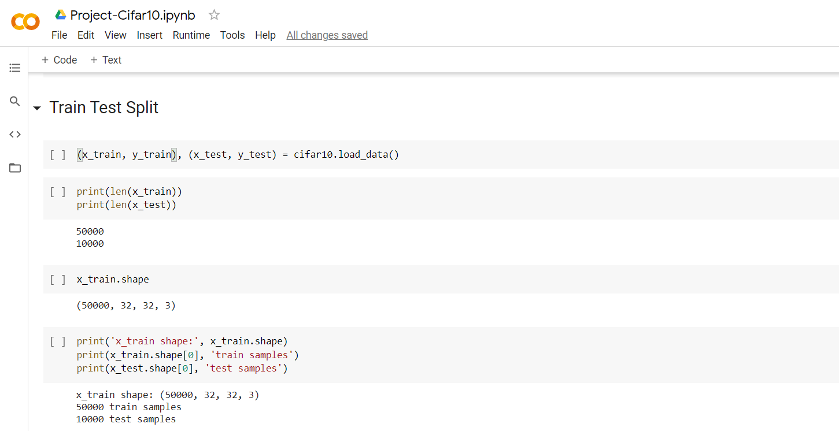
Train Test Split

Slide 12
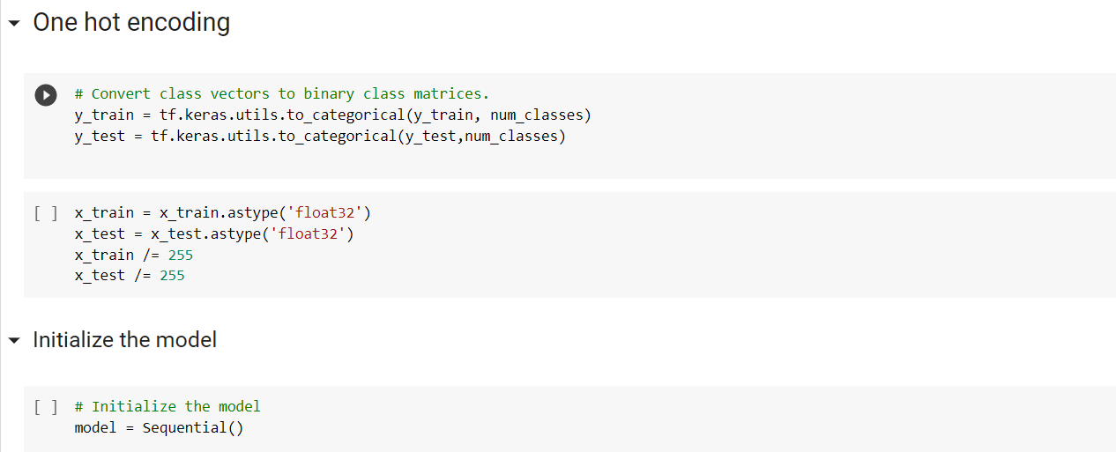
One hot encoding and model initialization

Slide 13
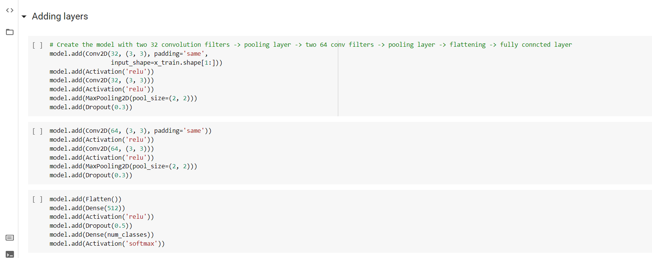
Adding Layers

Slide 14
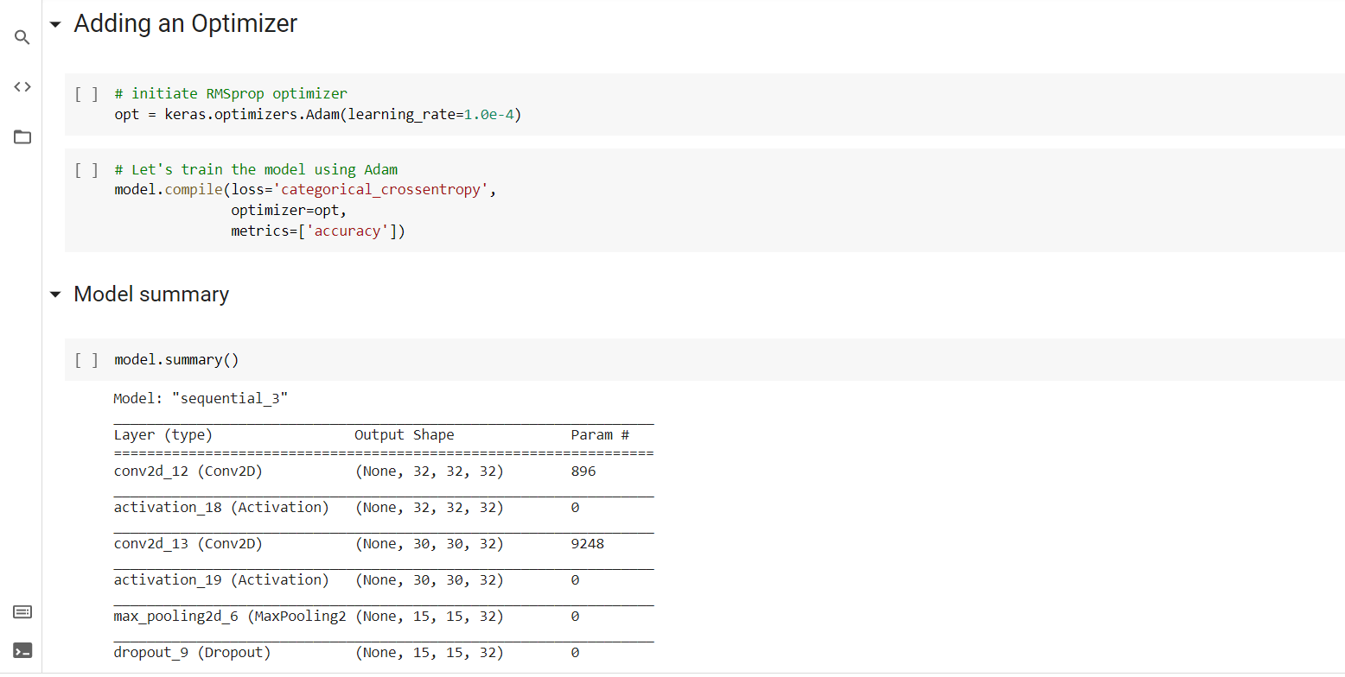
Optimizing and Summary

Slide 15
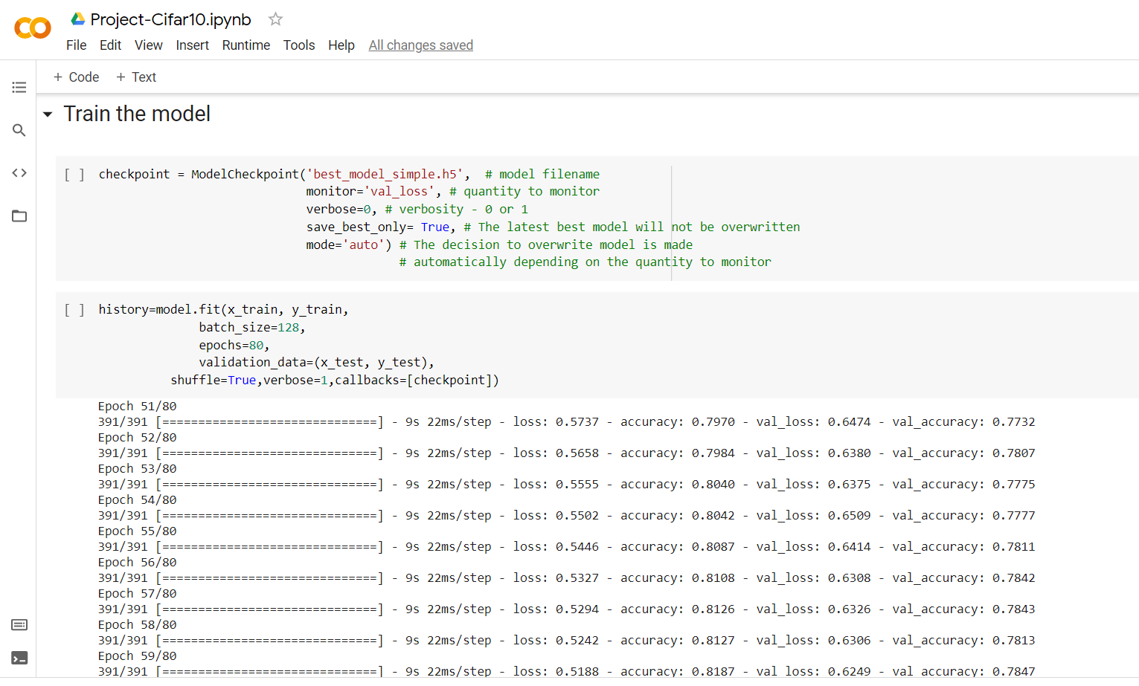
Training the Model

Slide 16
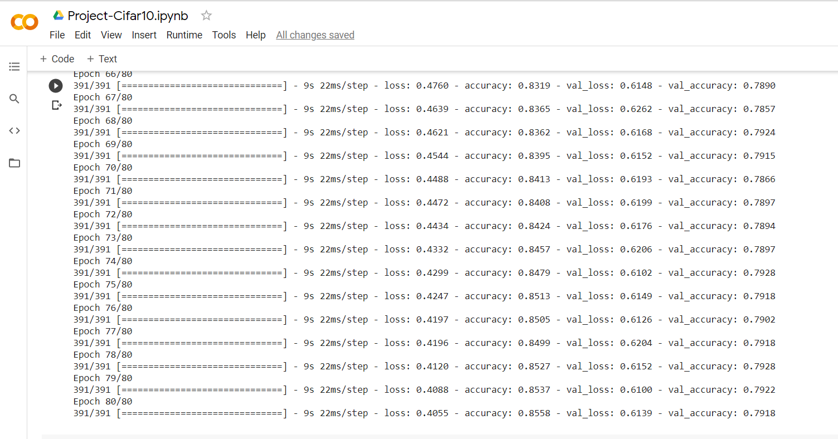
Accuracy and Val_accuracy

Slide 17
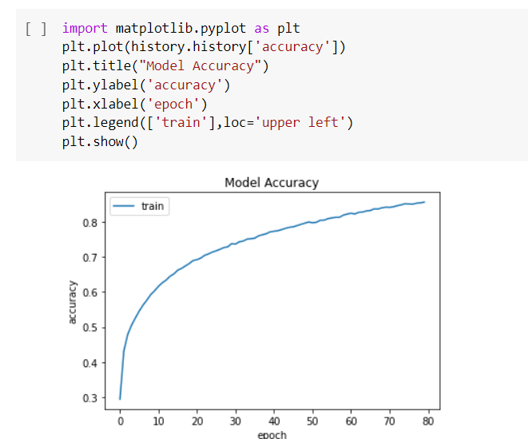
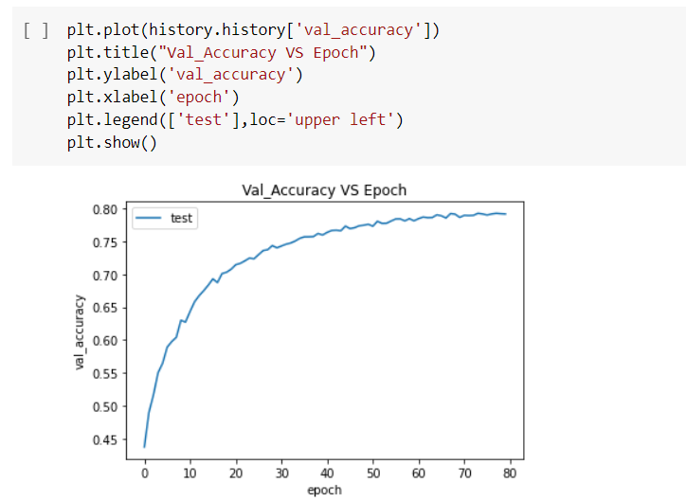
Accuracy, Val_accuracy VS Epochs

Slide 18
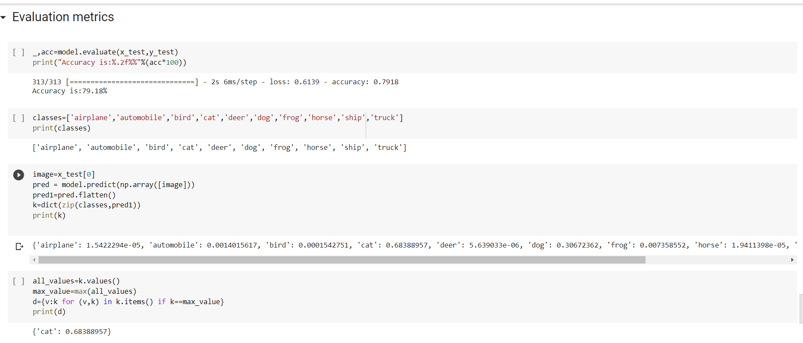
Model Evaluation

Slide 19
CONCLUSION
In the present work we have described a CNN model with having layers, optimization, tuning hyperparameters which led to good results along with predictions.
Despite little tuning of hyperparameters, a simple CNN with one layer of convolution performs remarkably well.
Our results add to the well-established evidence that the model is not got overfitted and the train and test accuracies are close to a decent level.
For Future work, we would look at improve the performance and give more accuracy using CNN.

Slide 20
Thank you

